Slide 1

Coffee Shop Data Dashboard

Slide 2
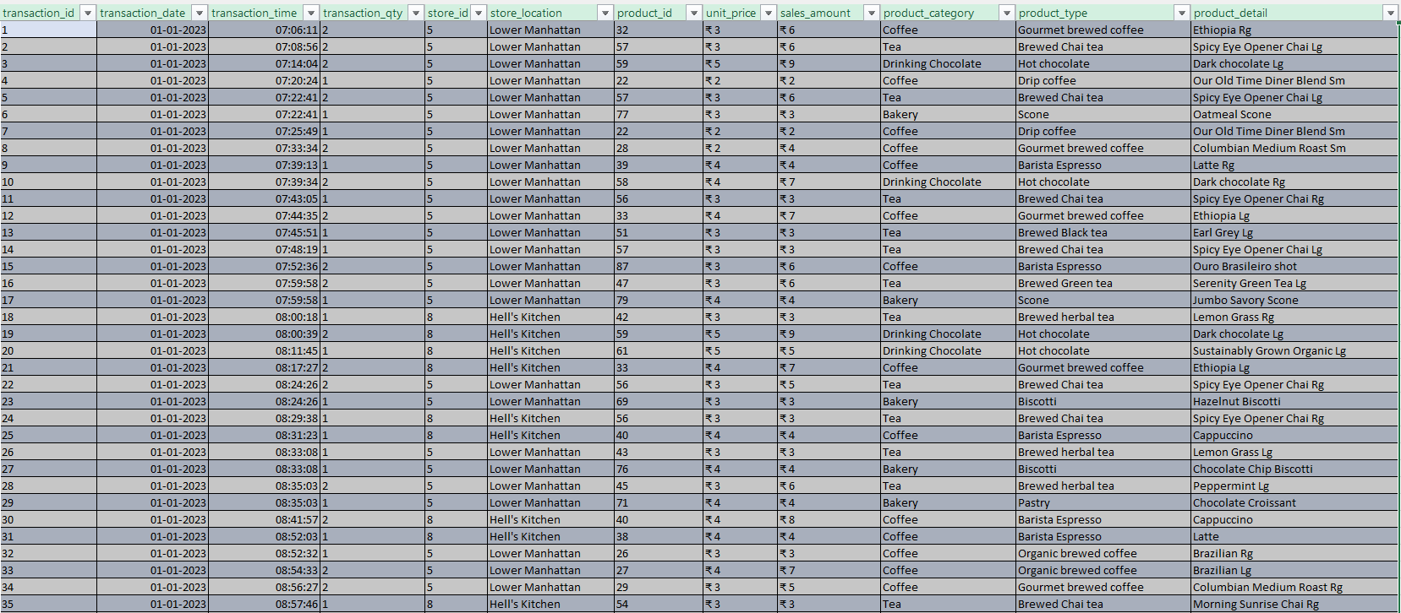
Raw Data

Slide 3
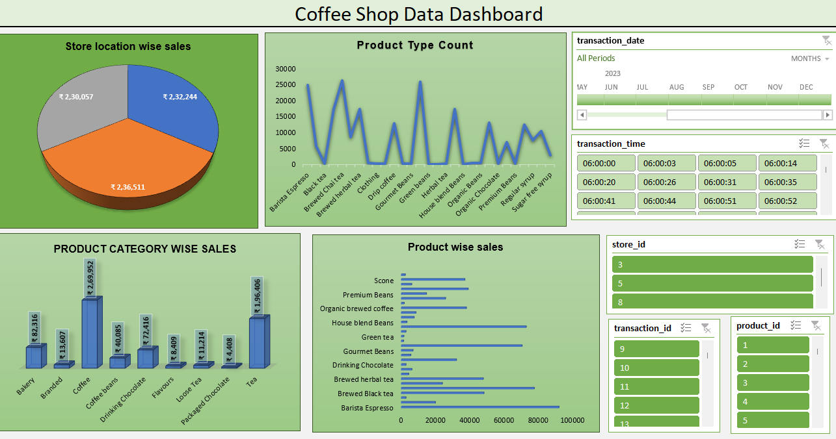
Coffee Shop Data Dashboard

Slide 4
Key insights
📊 THE BIG PICTURE
Total Revenue: ₹6,98,812 | Jan–Jun 2023
Growth: +103.8% (January → June)
3 Stores. Nearly equal revenue split (~33% each).
🔑 5 KEY INSIGHTS
1️⃣ Coffee leads, Tea follows strong
Coffee: 38.6% of revenue | Tea: 28.1%
Together → 66.7% of all revenue
Top product: Barista Espresso at ₹91,406
2️⃣ The morning rush IS the business
8 AM, 9 AM, 10 AM = 36.7% of daily revenue
If your peak 3 hours fail → you've lost more than ⅓ of the day

Slide 5
Key insights
3️⃣ March–May = hypergrowth window
+29.8% → +20.3% → +31.8% MoM
February dipped (-6.8%) but the business bounced back hard
4️⃣ All 3 stores are remarkably balanced
Hell's Kitchen: ₹2,36,511
Astoria: ₹2,32,244
Lower Manhattan: ₹2,30,057
No single location is a crutch. That's great operational health.
5️⃣ Premium products outperform
Sustainably Grown Organic Lg: ₹21,152 (Top SKU)
Dark Chocolate Lg: ₹21,006
Customers will pay more — if the product is worth it.

Slide 6
Takeaway
The takeaway?
Peak hours + premium products + a balanced store network = a scalable coffee business model.
What metric surprised you most? Drop it in the comments 👇
#DataAnalytics #BusinessInsights #CoffeeShop #DataVisualization #Excel #PowerBI #RetailAnalytics #LinkedInLearning

